Slide 1
COMMERCIAL USE OF THE RESULTS OF INDUSTRIAL RESEARCH AND EXPERIMENTAL DEVELOPMENT AND THEIR CONTRIBUTION TO ENVIRONMENTAL PROTECTION
A FLOATING DRONE FOR CHECKING THE TIGHTNESS OF LAGOONS AND RESERVOIRS
ARTUR Bobovnický, VLADIMÍR BORZA, Renáta Magulová, Tomáš GreGOR ET TOmÁŠ GREGOR |
Košice, 18. MÁJ 2023 | ENERGOFUTURA 2023

Slide 2
AIMS AND ELIGIBLE PROJECTS
AIMS:
developing innovative products
applications in all technological and application areas
EXPECTATIONS:
ready-to-market solutions
projects with strong market potential for both countries
Eligible projects under this Call are joint projects of industrial research and experimental development.
Support is only for projects bringing measurable and interpretable results, leading to a new product,
process or service, for example: semi operation, a certified technology, variety, patent, authorized software, utility model, industrial design and prototype functional sample.
ARTUR Bobovnický, VLADIMÍR BORZA, Renáta Magulová, Tomáš GreGOR ET TOmÁŠ GREGOR
|Košice, 18. MÁJ 2023 | ENERGOFUTURA 2023

Slide 3
Important notes
IMPORTANT NOTES
The aid is granted for a maximum period of 24 months.
The participants are required to have preliminary signed a partnership agreement on the commercialisation of the product,
process or service which should be developed by the joint project.
Projects in the frame of this announcement was financed by the respective national authorities in Slovakia & Israel, in accordance with the national laws, rules, regulations & procedures in effect.
ARTUR Bobovnický, VLADIMÍR BORZA, Renáta Magulová, Tomáš GreGOR ET TOmÁŠ GREGOR
|Košice, 18. MÁJ 2023 | ENERGOFUTURA 2023

Slide 4
THE AID INPUT FOR APPLICANTS
In Slovakia, the maximum amount of state aid per project is EUR 300 000. The aid input is 50% of the eligible costs of the industrial research projects activities and 25% of eligible costs of the experimental development.
In Israel, every selected project can be financed by Innovation Authority up to 50% (+ regional incentives for companies located in “development zone”)
of the eligible R&D costs.
ARTUR Bobovnický, VLADIMÍR BORZA, Renáta Magulová, Tomáš GreGOR ET TOmÁŠ GREGOR |
Košice, 18. MÁJ 2023 | ENERGOFUTURA 2023

Slide 5
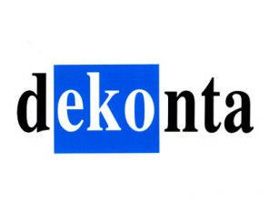
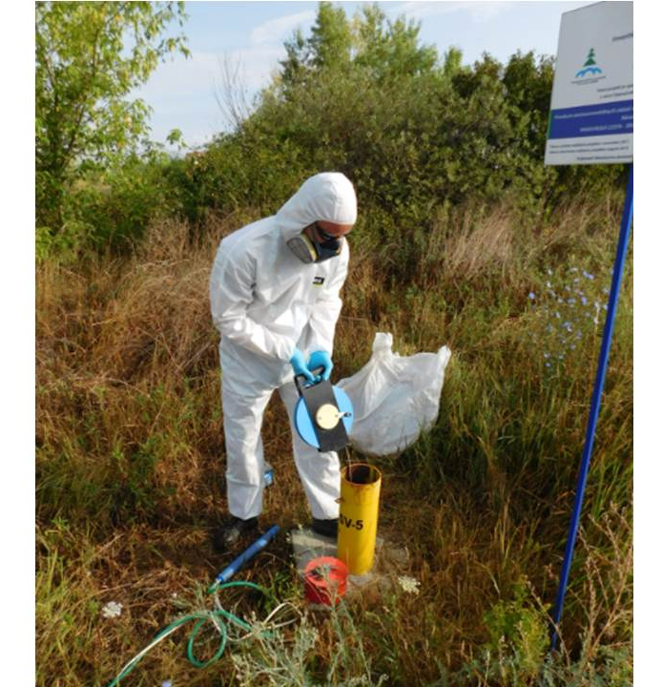
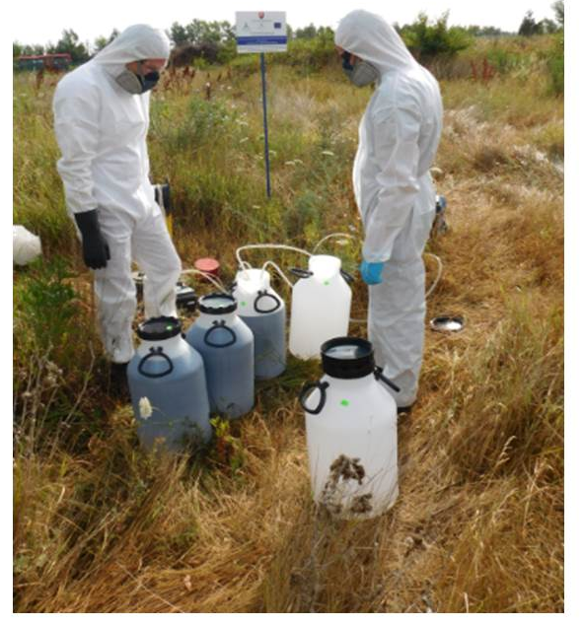
APPROVED PROJECTS – ZERRO WASTE TECHNOLOGY
DEKONTA Slovensko, spol. s r.o. – Aqwise
„Research on a new integrated process for the cleaning of groundwater contaminated with a mixture of organic and inorganic substances of industrial origin“
Environmental Sector
The aim of the proposed project was to create, through research activities, an innovative hybrid complex cleaning technology,
or remediation of contaminated groundwater.
Proven low-cost, sustainable "zero waste" technology
Intellectual property law - approved utility model
Acquired original know-how in the field of groundwater treatment with inorganic and organic pollution
Significant contribution of new knowledge to the problem of pilot locality of environmental burden - landfill of CHZJD company in Bratislava -Vrakuna
ARTUR Bobovnický, VLADIMÍR BORZA, Renáta Magulová, Tomáš GreGOR ET TOmÁŠ GREGOR |
Košice, 18. MÁJ 2023 | ENERGOFUTURA 2023

Slide 6
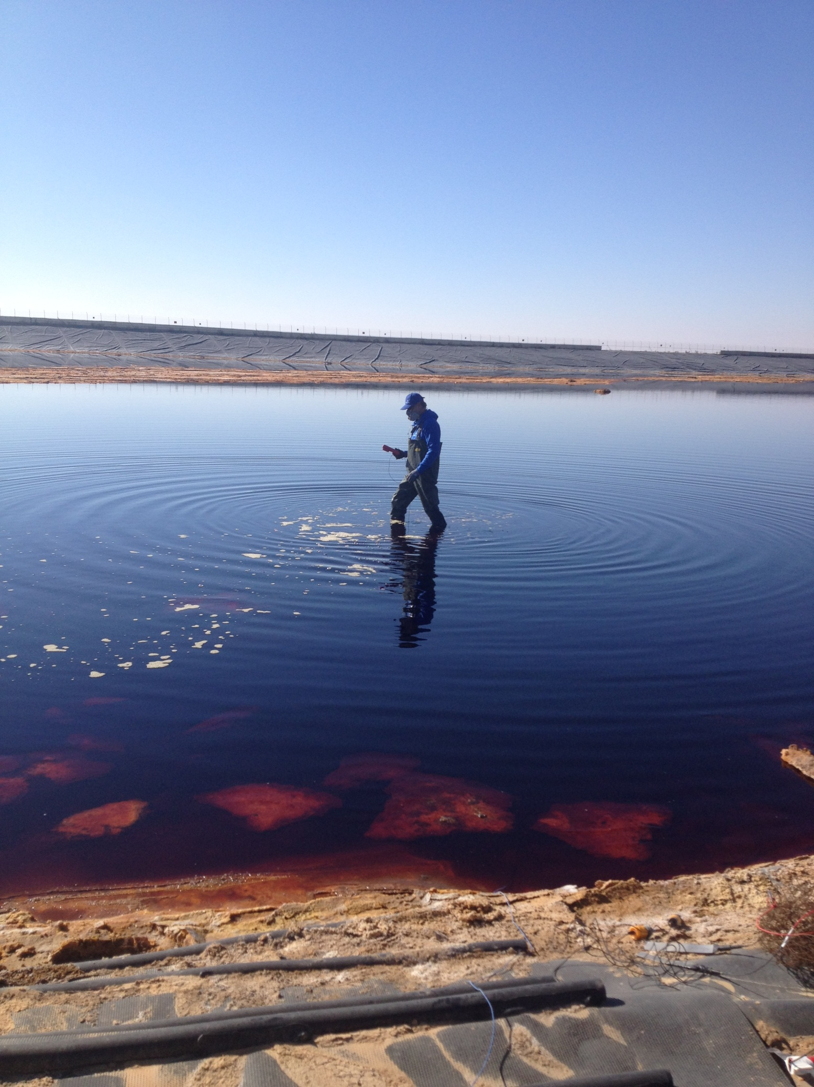
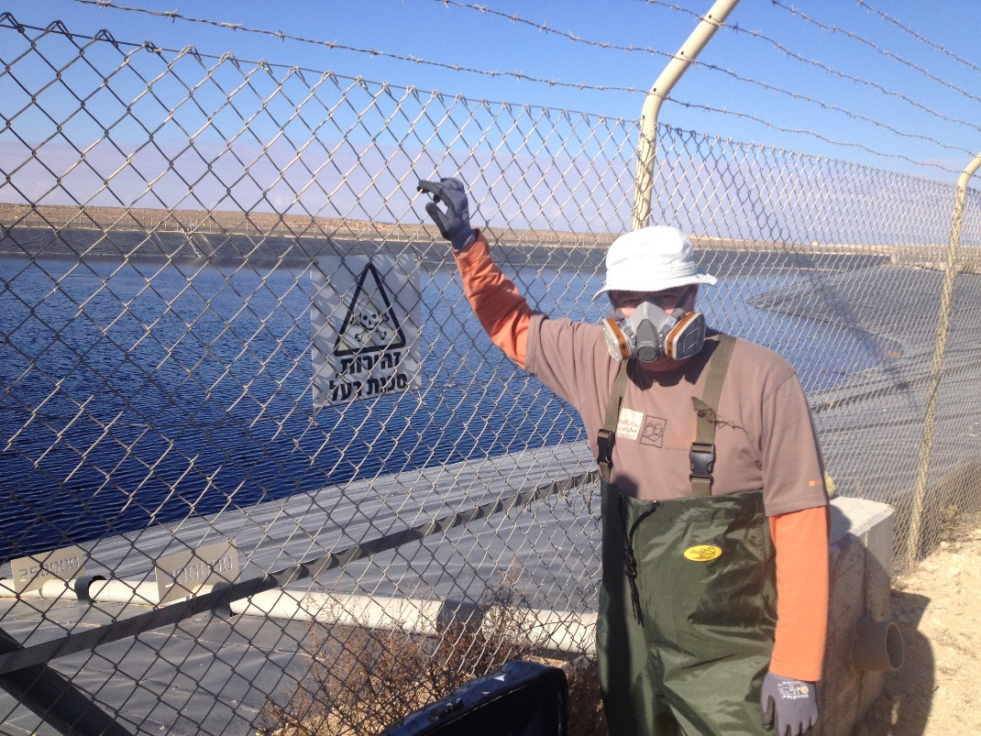
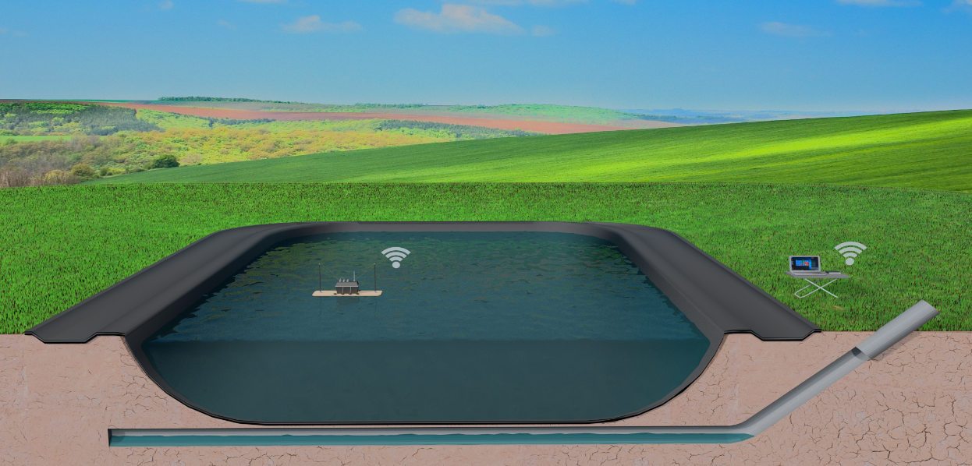
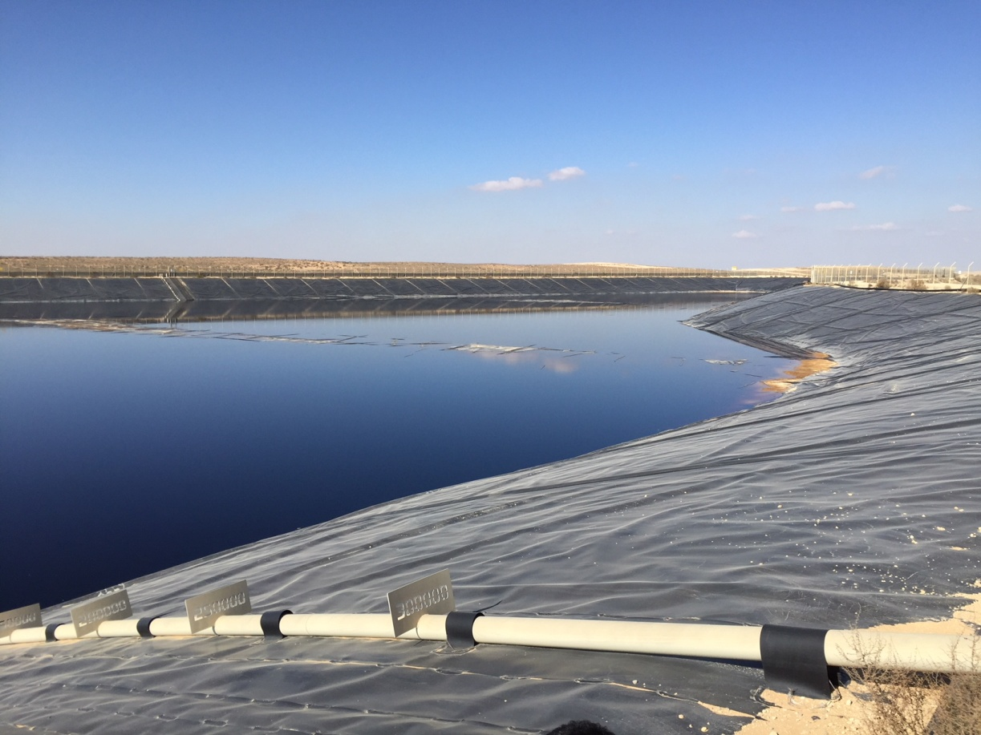
A FLOATING DRONE FOR CHECKING THE TIGHTNESS OF LAGOON AND RESERVOIRS
„Autonomous Automatic Floating Isolation
Monitoring Device“
Goal:
Research & Develop a device that will enable to detect leaks in lagoons with fluids in geomembrane insulation
Reason:
In the world and in Israel, there are many tanks and lagoons for toxic waste where leakage has occurred and has created and environmental contamination
Field: Environmental protection
Until now, the only possibility of monitoring the tightness was the measurement by a technician directly in the toxic lagoon, which was time-consuming and technically very demanding.
ARTUR Bobovnický, VLADIMÍR BORZA, Renáta Magulová, Tomáš GreGOR ET TOmÁŠ GREGOR |
Košice, 18. MÁJ 2023 | ENERGOFUTURA 2023

Slide 7
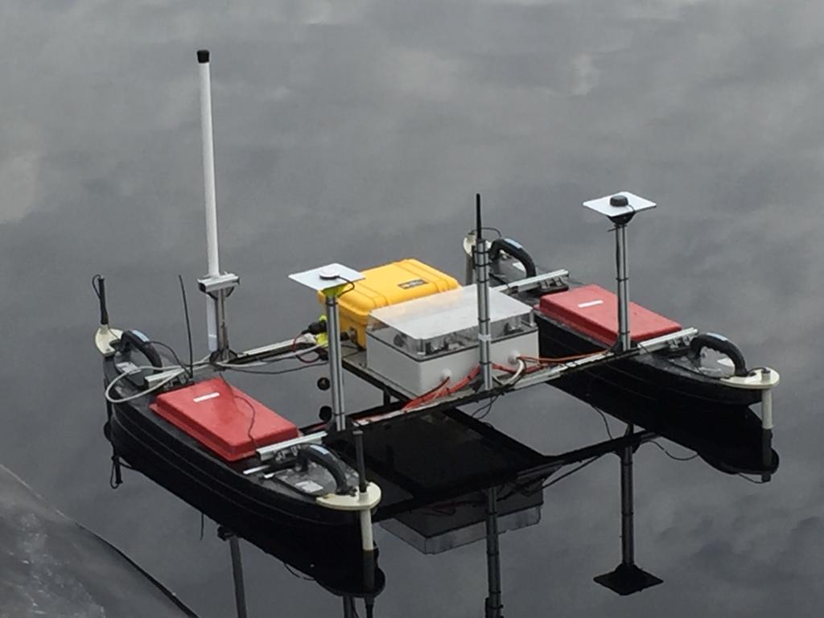
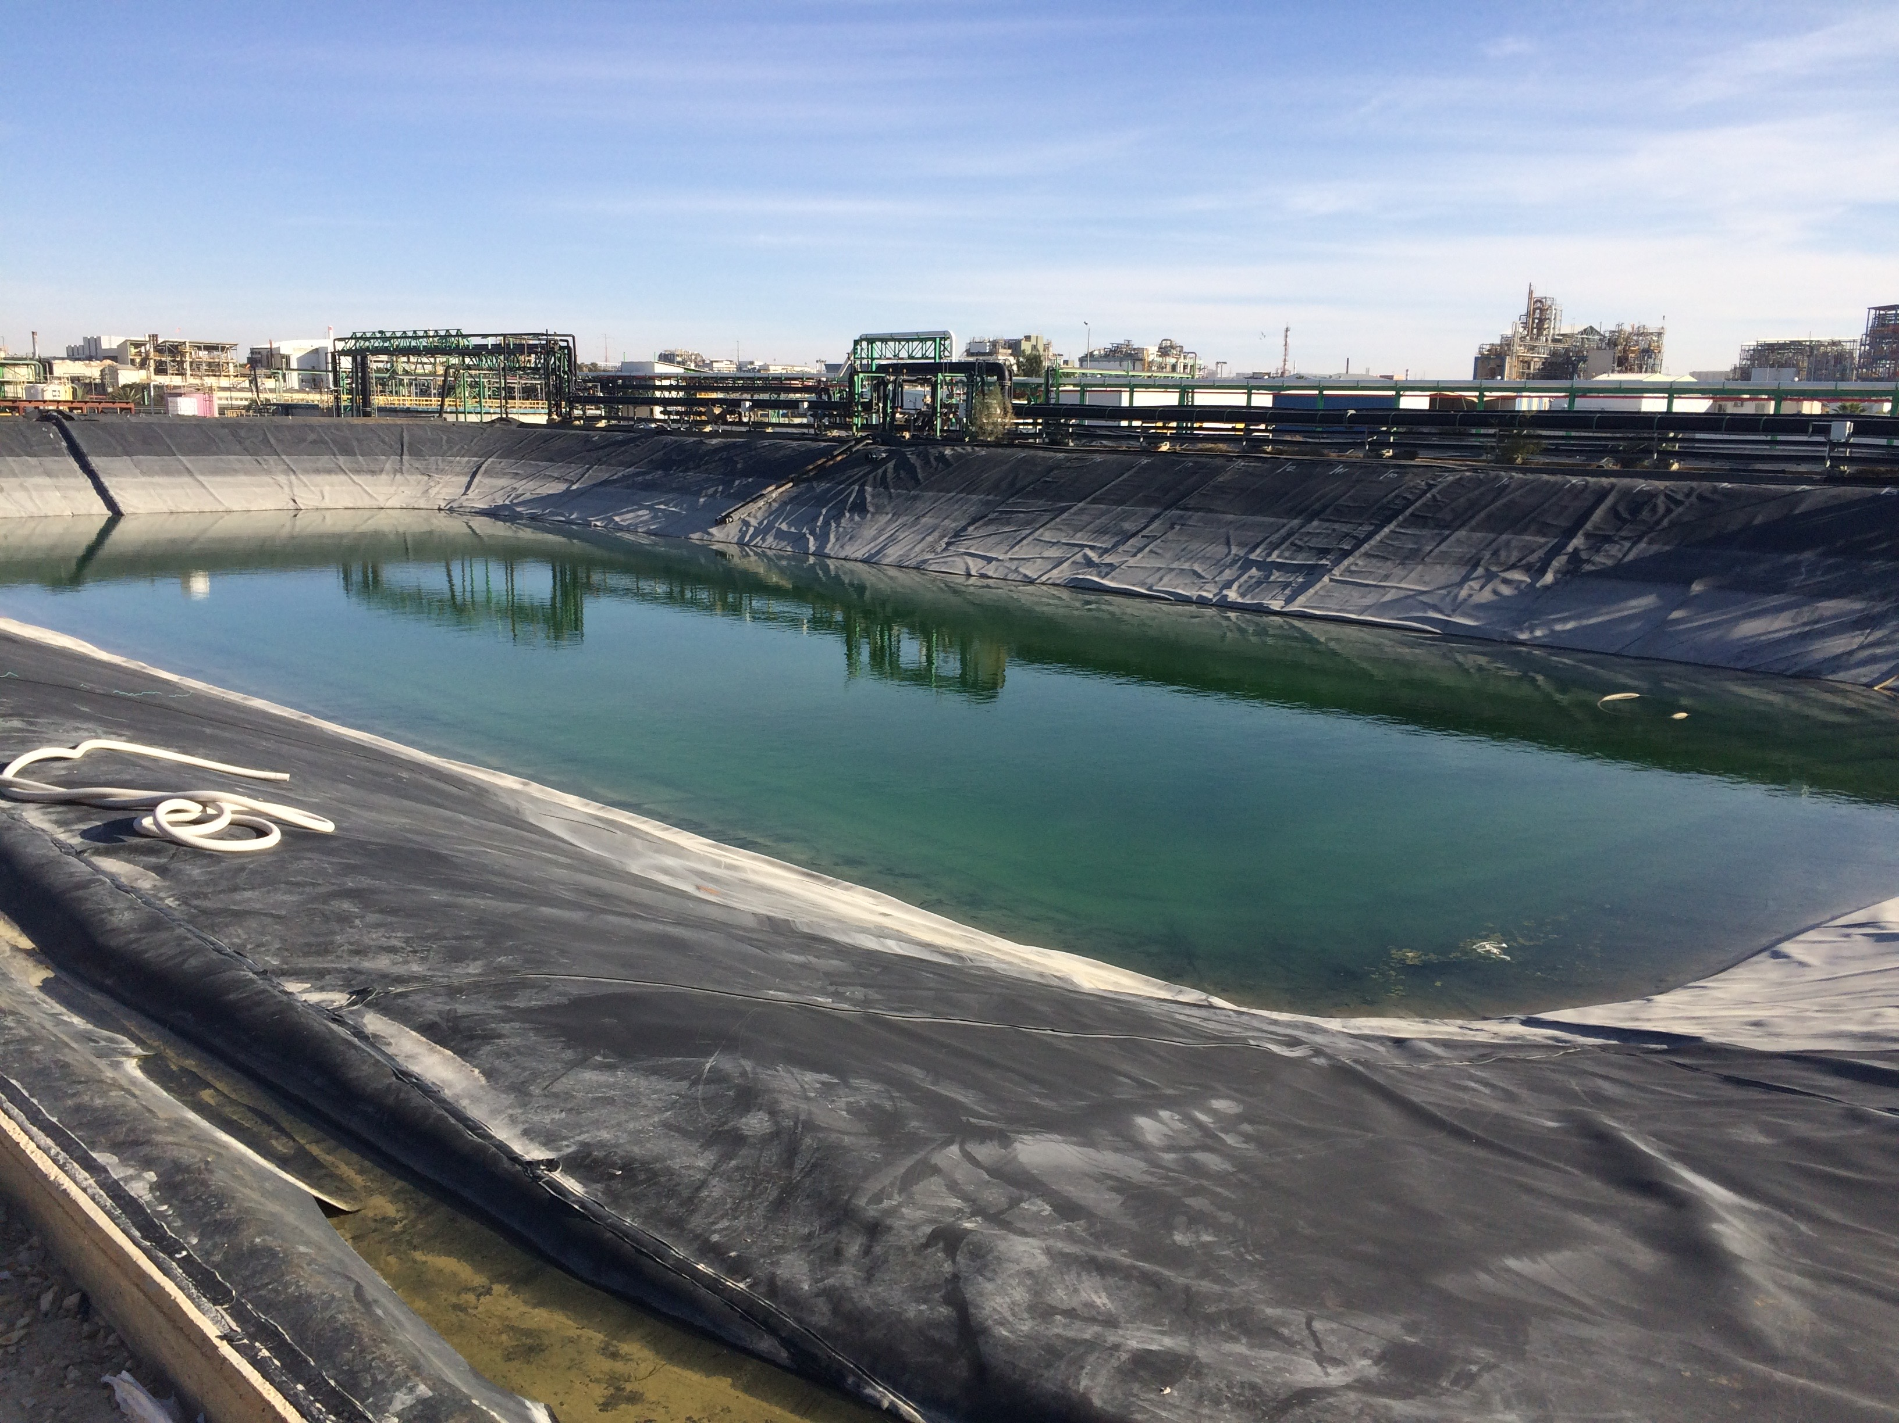
The prototype is a programmable device capable of independently performing monitoring measurements in toxic waste lagoons. At the same time, the data is processed and evaluated. In addition to a real and working prototype, the results of the project were submitted to the Office of Industrial Property in the form of a utility model.
ARTUR Bobovnický, VLADIMÍR BORZA, Renáta Magulová, Tomáš GreGOR ET TOmÁŠ GREGOR |
Košice, 18. MÁJ 2023 | ENERGOFUTURA 2023

Slide 8
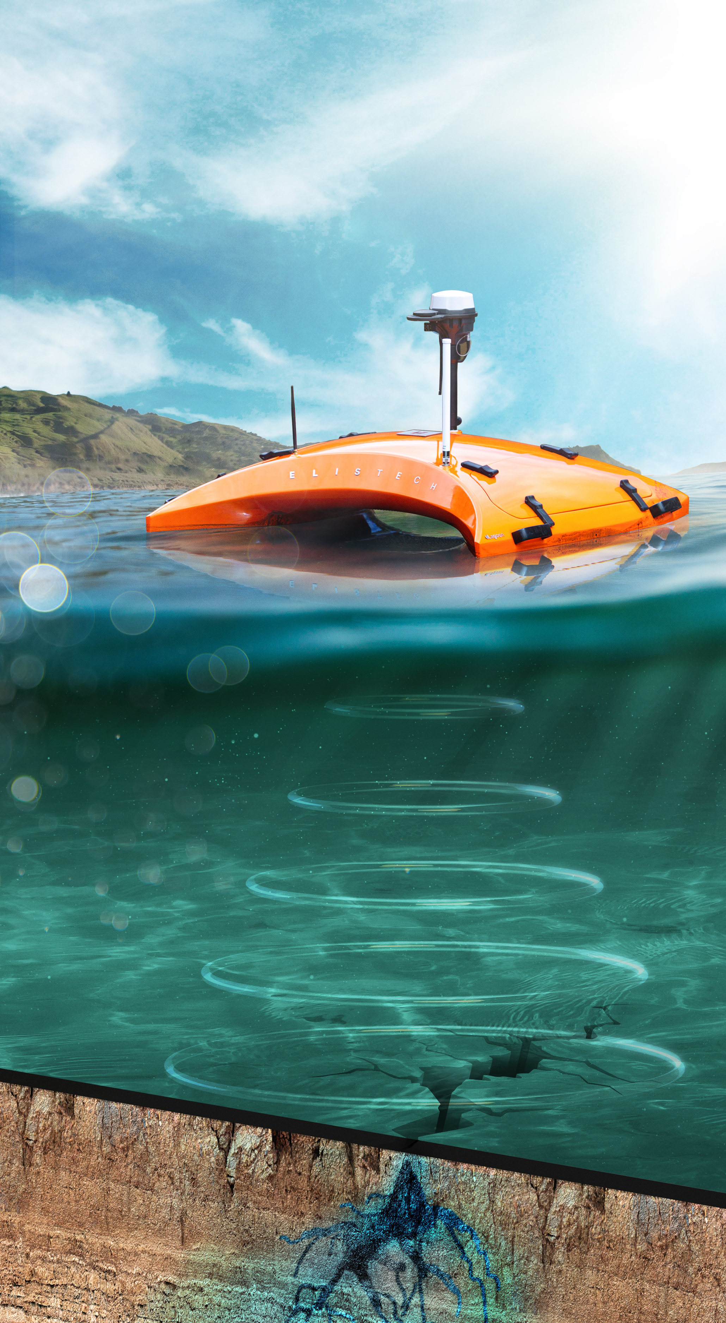
Autonomous Automatic Floating Isolation Monitoring Device - was subsequently technically improved and used to monitor lagoon tightness not only in Slovakia and Israel, but also in countries such as in the Czech Republic, Poland, Jordan and others.
ARTUR Bobovnický, VLADIMÍR BORZA, Renáta Magulová, Tomáš GreGOR ET TOmÁŠ GREGOR |
Košice, 18. MÁJ 2023 | ENERGOFUTURA 2023

Slide 9
Benefits and importance of cooperation for innovative companies of both countries
Developing of new innovative products /technologies or solutions
Covering current environmental issues /environmental protection
Interregional overlap
Networking with potential investors and business partners
Access to world markets
ARTUR Bobovnický, VLADIMÍR BORZA, Renáta Magulová, Tomáš GreGOR ET TOmÁŠ GREGOR |
Košice, 18. MÁJ 2023 | ENERGOFUTURA 2023

Slide 10
ARTUR Bobovnický, VLADIMÍR BORZA, Renáta Magulová, Tomáš GreGOR ET TOmÁŠ GREGOR |
Košice, 18. MÁJ 2023 | ENERGOFUTURA 2023

